Slide 1


Big Data Infrastructure
CS 489/698 Big Data Infrastructure (Winter 2016)
Week 5: Analyzing Graphs (1/2)
February 2, 2016
Jimmy Lin
David R. Cheriton School of Computer Science
University of Waterloo
These slides are available at http://lintool.github.io/bigdata-2016w/
This work is licensed under a Creative Commons Attribution-Noncommercial-Share Alike 3.0 United States See http://creativecommons.org/licenses/by-nc-sa/3.0/us/ for details

Slide 2
Structure of the Course
Analyzing Text
Analyzing Relational Data
Analyzing Graphs
Data Mining
“Core” framework features and algorithm design

Slide 3
What’s a graph?
G = (V,E), where
V represents the set of vertices (nodes)
E represents the set of edges (links)
Both vertices and edges may contain additional information
Different types of graphs:
Directed vs. undirected edges
Presence or absence of cycles
Graphs are everywhere:
Hyperlink structure of the web
Physical structure of computers on the Internet
Interstate highway system
Social networks

Slide 4
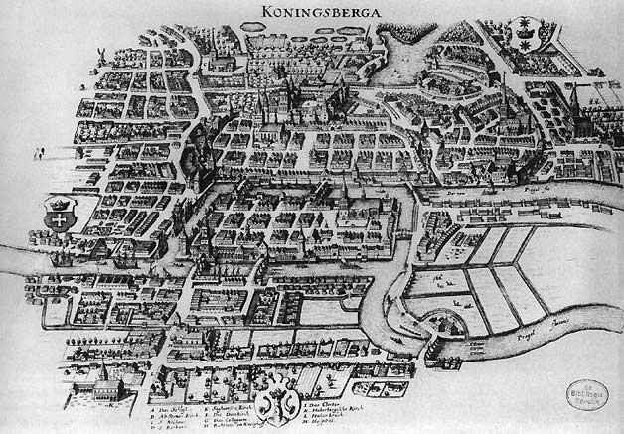
Source: Wikipedia (Königsberg)

Slide 5
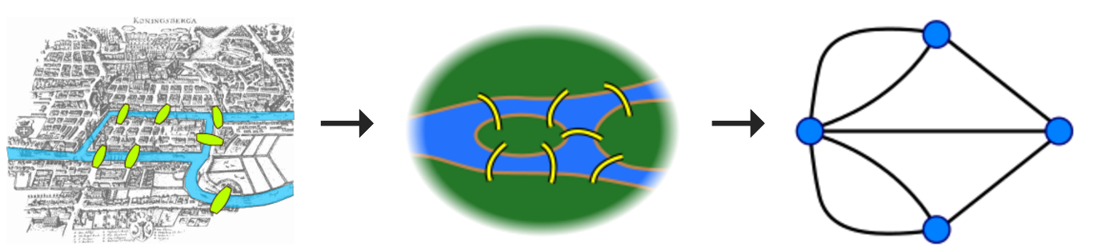

Slide 6
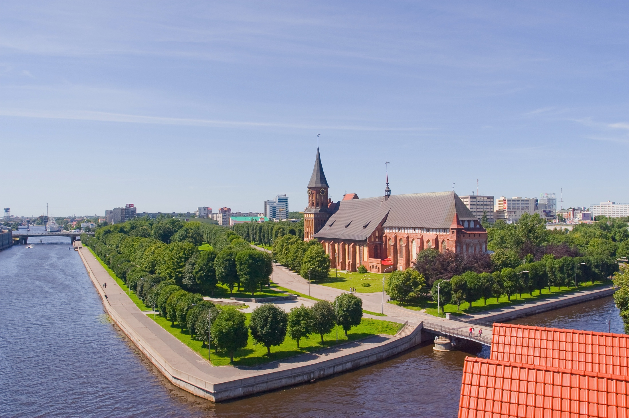
Source: Wikipedia (Kaliningrad)

Slide 7
Some Graph Problems
Finding shortest paths
Routing Internet traffic and UPS trucks
Finding minimum spanning trees
Telco laying down fiber
Finding Max Flow
Airline scheduling
Identify “special” nodes and communities
Breaking up terrorist cells, spread of avian flu
Bipartite matching
Monster.com, Match.com
And of course... PageRank

Slide 8
Graphs and MapReduce (and Spark)
A large class of graph algorithms involve:
Performing computations at each node: based on node features, edge features, and local link structure
Propagating computations: “traversing” the graph
Key questions:
How do you represent graph data in MapReduce (and Spark)?
How do you traverse a graph in MapReduce (and Spark)?

Slide 9
Representing Graphs
G = (V, E)
Three common representations
Adjacency matrix
Adjacency list
Edge lists

Slide 10
Adjacency Matrices
Represent a graph as an n x n square matrix M
n = |V|
M_{ij} = 1 means a link from node i to j
2
 | 1 | 2 | 3 | 4
1 | 0 | 1 | 0 | 1
2 | 1 | 0 | 1 | 1
3 | 1 | 0 | 0 | 0
4 | 1 | 0 | 1 | 0
1
3
4

Slide 11
Adjacency Matrices: Critique
Advantages:
Amenable to mathematical manipulation
Iteration over rows and columns corresponds to computations on outlinks and inlinks
Disadvantages:
Lots of zeros for sparse matrices
Lots of wasted space

Slide 12
Adjacency Lists
Take adjacency matrices… and throw away all the zeros
 | 1 | 2 | 3 | 4
1 | 0 | 1 | 0 | 1
2 | 1 | 0 | 1 | 1
3 | 1 | 0 | 0 | 0
4 | 1 | 0 | 1 | 0
1: 2, 4
2: 1, 3, 4
3: 1
4: 1, 3
Wait, where have we seen this before?

Slide 13
Adjacency Lists: Critique
Advantages:
Much more compact representation
Easy to compute over outlinks
Disadvantages:
Much more difficult to compute over inlinks

Slide 14
Edge Lists
Explicitly enumerate all edges
(1, 2)
(1, 4)
(2, 1)
(2, 3)
(2, 4)
(3, 1)
(4, 1)
(4, 3)
 | 1 | 2 | 3 | 4
1 | 0 | 1 | 0 | 1
2 | 1 | 0 | 1 | 1
3 | 1 | 0 | 0 | 0
4 | 1 | 0 | 1 | 0

Slide 15
Edge Lists: Critique
Why?
Edges arrive in no particular order
Sometimes, we want to store inverted edges
Advantages:
Supports the ability to perform edge partitioning
Disadvantages:
Takes a lot of space

Slide 16
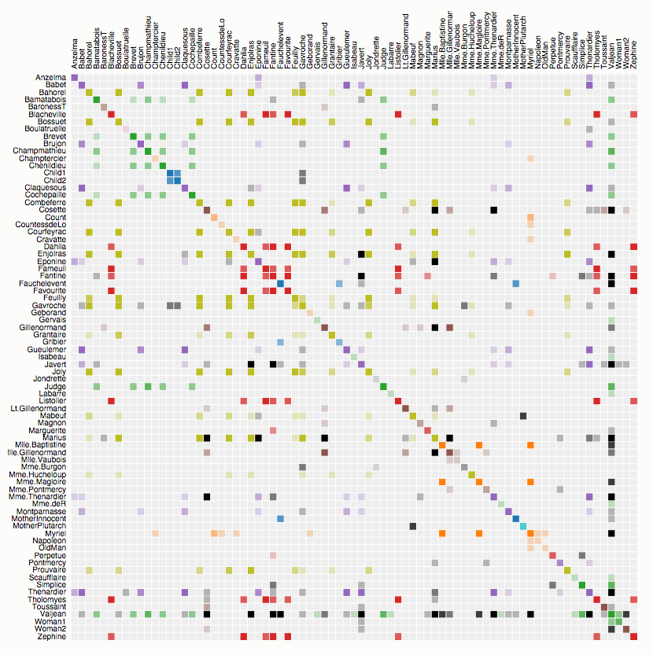
Co-occurrence of characters in Les Misérables
Source: http://bost.ocks.org/mike/miserables/

Slide 17
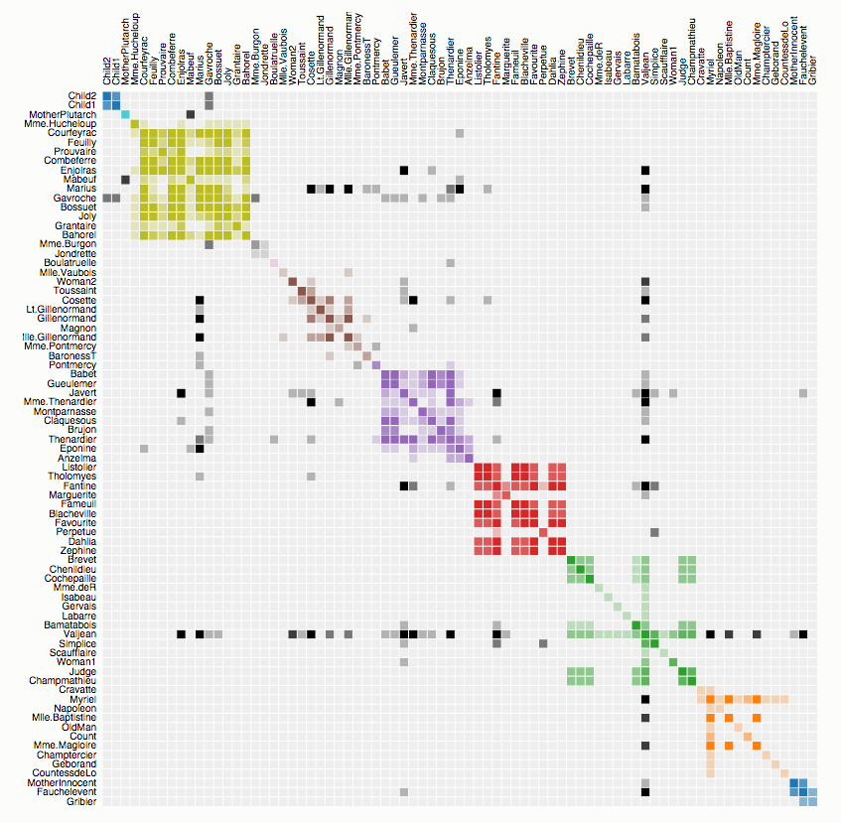
Co-occurrence of characters in Les Misérables
Source: http://bost.ocks.org/mike/miserables/

Slide 18
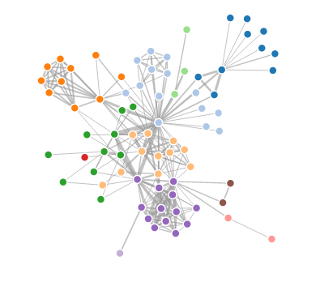
Co-occurrence of characters in Les Misérables
How are visualizations like this generated?
Limitations?
Source: http://bost.ocks.org/mike/miserables/

Slide 19
What does the web look like?
Analysis of a large webgraph from the common crawl: 3.5 billion pages, 129 billion pages
Meusel et al. Graph Structure in the Web — Revisited. WWW 2014.

Slide 20
Broder’s Bowtie (2000) – revisited

Slide 21
What does the web look like?
Very roughly, a scale-free network
Fraction of k nodes having k connections:
(i.e., distribution follows a power law)

Slide 24
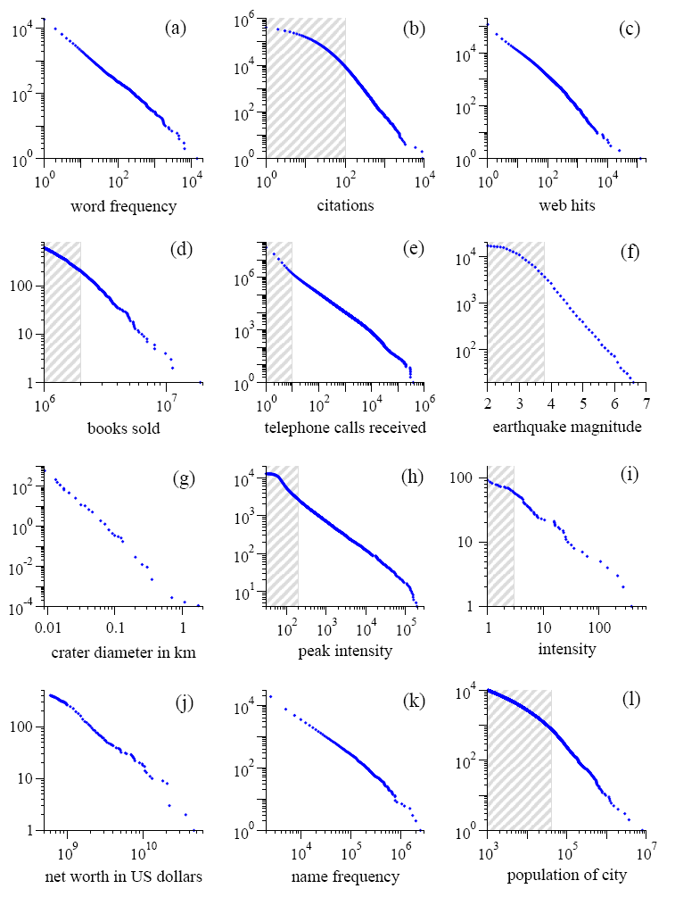
Power Laws are everywhere!
Figure from: Newman, M. E. J. (2005) “Power laws, Pareto distributions and Zipf's law.” Contemporary Physics 46:323–351.

Slide 25
What does the web look like?
Very roughly, a scale-free network
Other Examples:
Internet domain routers
Co-author network
Citation network
Movie-Actor network
Why?

Slide 26
(In this installment of “learn fancy terms for simple ideas”)
Preferential Attachment
Also:
Matthew Effect
For unto every one that hath shall be given, and he shall have abundance: but from him that hath not shall be taken even that which he hath.
— Matthew 25:29, King James Version.

Slide 27
What about Facebook?
Figure from: Seth A. Myers, Aneesh Sharma, Pankaj Gupta, and Jimmy Lin. Information Network or Social Network? The Structure of the Twitter Follow Graph. WWW 2014.

Slide 28
BTW, how do we compute these graphs?
(Assume graph stored as adjacency lists)

Slide 29

Count.
Source: http://www.flickr.com/photos/guvnah/7861418602/

Slide 30
BTW, how do we extract the webgraph?
The webgraph… is big?!
A few tricks:
Integerize vertices (montone minimal perfect hashing)
Sort URLs
Integer compression
webgraph from the common crawl: 3.5 billion pages, 129 billion pages
58 GB!
Meusel et al. Graph Structure in the Web — Revisited. WWW 2014.

Slide 31
Graphs and MapReduce (and Spark)
A large class of graph algorithms involve:
Performing computations at each node: based on node features, edge features, and local link structure
Propagating computations: “traversing” the graph
Key questions:
How do you represent graph data in MapReduce (and Spark)?
How do you traverse a graph in MapReduce (and Spark)?

Slide 32
Single-Source Shortest Path
Problem: find shortest path from a source node to one or more target nodes
Shortest might also mean lowest weight or cost
First, a refresher: Dijkstra’s Algorithm

Slide 33
Dijkstra’s Algorithm Example
∞
1
∞
10
0
2
3
9
4
6
5
7
∞
∞
2
Example from CLR

Slide 34
Dijkstra’s Algorithm Example
10
1
∞
10
0
2
3
9
4
6
5
7
5
∞
2
Example from CLR

Slide 35
Dijkstra’s Algorithm Example
8
1
14
10
0
2
3
9
4
6
5
7
5
7
2
Example from CLR

Slide 36
Dijkstra’s Algorithm Example
8
1
13
10
0
2
3
9
4
6
5
7
5
7
2
Example from CLR

Slide 37
Dijkstra’s Algorithm Example
8
1
9
1
10
0
2
3
9
4
6
5
7
5
7
2
Example from CLR

Slide 38
Dijkstra’s Algorithm Example
8
1
9
10
0
2
3
9
4
6
5
7
5
7
2
Example from CLR

Slide 39
Single-Source Shortest Path
Problem: find shortest path from a source node to one or more target nodes
Shortest might also mean lowest weight or cost
Single processor machine: Dijkstra’s Algorithm
MapReduce: parallel breadth-first search (BFS)

Slide 40
Finding the Shortest Path
Consider simple case of equal edge weights
Solution to the problem can be defined inductively
Here’s the intuition:
Define: b is reachable from a if b is on adjacency list of a
DistanceTo(s) = 0
For all nodes p reachable from s, DistanceTo(p) = 1
For all nodes n reachable from some other set of nodes M, DistanceTo(n) = 1 + min(DistanceTo(m), m ∈ M)
d₁
m₁
…
d₂
s
…
n
m₂
…
d₃
m₃

Slide 41

Source: Wikipedia (Wave)

Slide 42
Visualizing Parallel BFS
n₇
n₀
n₁
n₃
n₂
n₆
n₅
n₄
n₈
n₉

Slide 43
From Intuition to Algorithm
Data representation:
Key: node n
Value: d (distance from start), adjacency list (nodes reachable from n)
Initialization: for all nodes except for start node, d = ∞
Mapper:
∀m ∈ adjacency list: emit (m, d + 1)
Remember to also emit distance to yourself
Sort/Shuffle
Groups distances by reachable nodes
Reducer:
Selects minimum distance path for each reachable node
Additional bookkeeping needed to keep track of actual path

Slide 44
Multiple Iterations Needed
Each MapReduce iteration advances the “frontier” by one hop
Subsequent iterations include more and more reachable nodes as frontier expands
Multiple iterations are needed to explore entire graph
Preserving graph structure:
Problem: Where did the adjacency list go?
Solution: mapper emits (n, adjacency list) as well
Ugh! This is ugly!

Slide 45
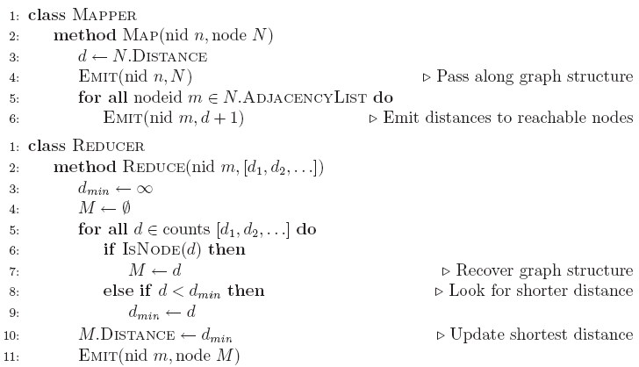
BFS Pseudo-Code

Slide 46
Stopping Criterion
How many iterations are needed in parallel BFS (equal edge weight case)?
Convince yourself: when a node is first “discovered”, we’ve found the shortest path
Now answer the question...
Six degrees of separation?
Practicalities of implementation in MapReduce

Slide 47
Comparison to Dijkstra
Dijkstra’s algorithm is more efficient
At each step, only pursues edges from minimum-cost path inside frontier
MapReduce explores all paths in parallel
Lots of “waste”
Useful work is only done at the “frontier”
Why can’t we do better using MapReduce?

Slide 48
Single Source: Weighted Edges
Now add positive weights to the edges
Why can’t edge weights be negative?
Simple change: add weight w for each edge in adjacency list
In mapper, emit (m, d + w_{p}) instead of (m, d + 1) for each node m
That’s it?

Slide 49
Stopping Criterion
How many iterations are needed in parallel BFS (positive edge weight case)?
Convince yourself: when a node is first “discovered”, we’ve found the shortest path
Not true!

Slide 50
Additional Complexities
search frontier
1
n₆
1
n₇
1
n₈
r
10
1
n₅
n₉
n₁
s
1
1
p
q
n₄
1
n₂
1
n₃

Slide 51
Stopping Criterion
How many iterations are needed in parallel BFS (positive edge weight case)?
Practicalities of implementation in MapReduce

Slide 52
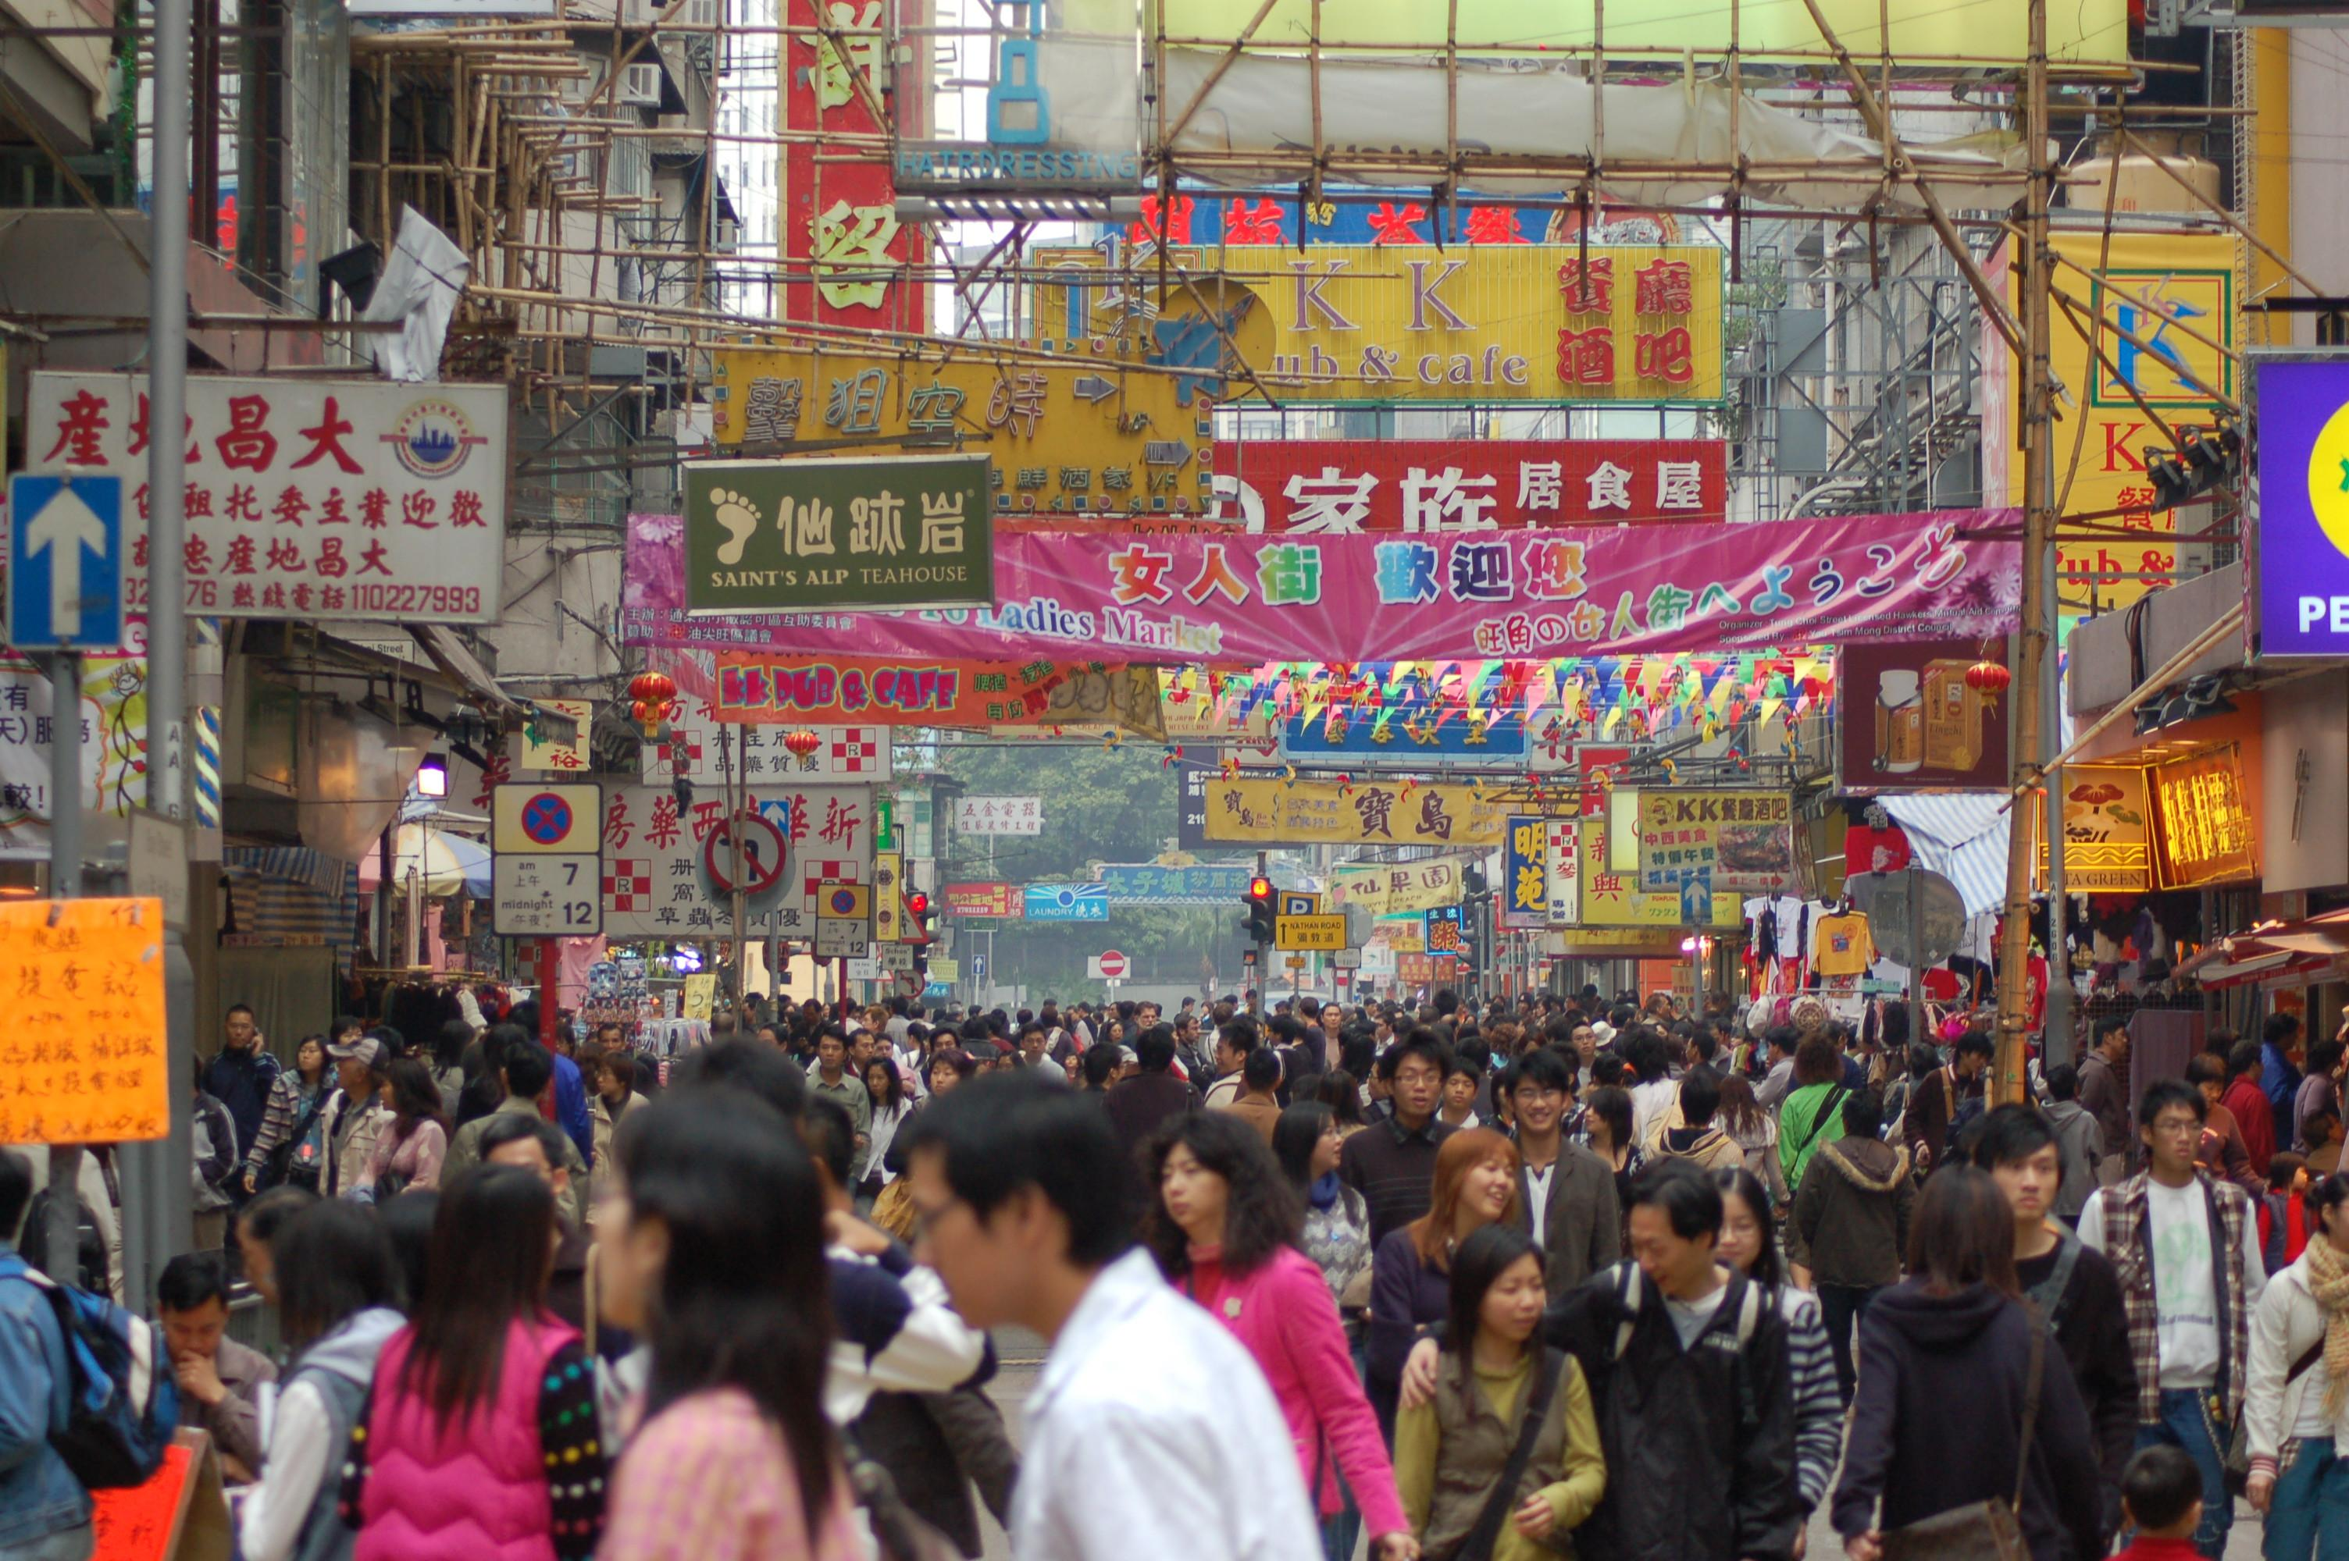
Application: Social Search
Source: Wikipedia (Crowd)

Slide 53
Social Search
When searching, how to rank friends named “John”?
Assume undirected graphs
Rank matches by distance to user
Naïve implementations:
Precompute all-pairs distances
Compute distances at query time
Can we do better?

Slide 54
All-Pairs?
Floyd-Warshall Algorithm: difficult to MapReduce-ify…
Multiple-source shortest paths in MapReduce: run multiple parallel BFS simultaneously
Assume source nodes {s₀, s₁, … s_{n}}
Instead of emitting a single distance, emit an array of distances, with respect to each source
Reducer selects minimum for each element in array
Does this scale?

Slide 55
Landmark Approach (aka sketches)
Select n seeds {s₀, s₁, … s_{n}}
Compute distances from seeds to every node:
What can we conclude about distances?
Insight: landmarks bound the maximum path length
Lots of details:
How to more tightly bound distances
How to select landmarks (random isn’t the best…)
Use multi-source parallel BFS implementation in MapReduce!
A = [2, 1, 1]
B = [1, 1, 2]
C = [4, 3, 1]
D = [1, 2, 4]
Nodes
Distances to seeds

Slide 56

Questions?
Source: Wikipedia (Japanese rock garden)

